Slide 1
Grouping and Summarizing Data
Patrick Mathias
Lab Medicine Core

Slide 2
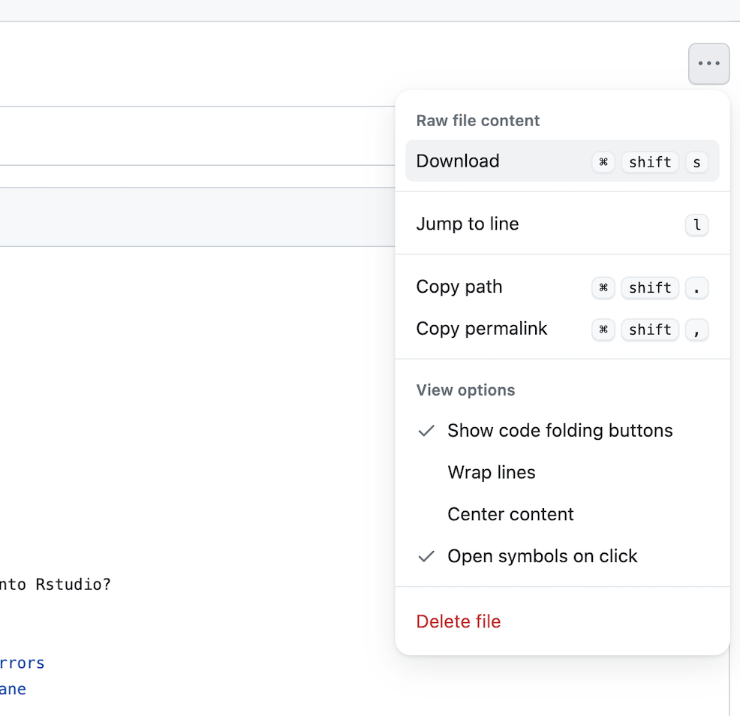
Lesson Prep
Locate the “05 – Group and Summarize” qmd file on the course website.
Navigate to the file and use the menu on the top right to download.
Upload to your core folder on the RStudio server

Slide 3
Lesson Goals
Construct a table that summarizes basic statistics (e.g., count, proportion, mean, range) of a dataset and its subgroups
Utilize programming and software tools to facilitate efficient, reproducible, and transparent data analytics workflows
Lesson Objectives
Link sequential data analysis steps together using the pipe operator to improve readability
Calculate a summary statistic for a variable using the summarize() function
Combine group_by() and summarize() functions to calculate summary statistics for groups of data

Slide 4
Typical Data Science Pipeline
From R for Data Science (https://r4ds.had.co.nz/introduction.html)
Notes:
In this session we will continue our focus on transformation and introduce some tools for basic statistics and modeling also.

Slide 5
Piping Data from One Row to the Next
Notes:
The first set of functions we will explore will be ones whose primary goal is to extracting the data of interest from a large and often messy pile of data.
Reducing a dataset to a narrow subset of columns and rows is often the first step in an analysis.

Slide 6
Reviewing turnaround times
We are interested in focusing on specific measurements and calculating turnaround times for different populations in our data set. We would like to start with our sodium values and calculate the total turnaround times for only those observations.

Slide 7
Data Analysis Steps
tat_outliers <- filter(chem, value == ‘sodium’)
tat_outliers <- mutate(tat_outliers,
total_tat = verify_dt – collect_dt)
1. Filter to extract the subset of sodium
2. Mutate to add a column for total turnaround time

Slide 8
Reviewing turnaround times
We are interested in focusing on specific measurements and calculating turnaround times for different populations in our data set. We would like to start with our sodium values and calculate the total turnaround times for only those observations.
Now we want to focus on only the tests with a turnaround time of greater than 5 days.

Slide 9
Data Analysis Steps
tat_outliers <- filter(chem, test == ‘sodium’)
tat_outliers <- mutate(tat_outliers,
total_tat = verify_dt – collect_dt)
tat_outliers <- filter(tat_outliers, total_tat > days(5))
1. Filter to extract the subset of sodium
2. Mutate to add a column for total turnaround time
3. Filter to extract only the results with a TAT of more than 5 days
Creates a duration of 5 days
Notes:
Relatively inefficient: we are typing tat_outliers over and over again

Slide 10
The Pipe Operator |>
Passes result on left into first argument of function on right.
chem
|>
filter(____, test == ‘sodium’)
filter(chem, test == ‘sodium’)
chem |> filter(test == ‘sodium’)
Notes:
This is exactly what the pipe operator does.
The pipe operator is this percent, greater than, percent symbol. It's a tool that we use to glue the pieces of our analysis together into one pipeline.
The pipe operator does something very simple but at the same time incredible useful. It takes the product of whatever is on the left and puts it into the function on the right.
So for example, the two lines of code in the gray box do exactly the same thing.
There are a whole bunch of reasons as to why this is a useful thing but for me, one of the most important reasons is that it turns computer code into something that is almost legible as human language.
You could essentially read the second line of code as “Take the covid_testing data frame, and then filter the pan_day column to rows that are less than or equal to 10.”

Slide 11
Data Analysis Steps
new data frame
original data frame
one analysis step per line
tat_outliers <- chem |>
filter(test == ‘sodium’) |>
mutate(total_tat = verify_dt – collect_dt) |>
filter(total_tat > days(5))
1. Filter to extract the subset of sodium
2. Mutate to add a column for total turnaround time
3. Filter to extract only the outpatient results
Notes:
The code here is far more succinct. It's essentially self describing since it’s written in a sequential, essentially human readable format.
The pipe operator allows us to form chains that accomplish complicated data transformation operations but which are made up of very simple, self-contained, building blocks. So we're able to make something complex by joining together many simple elements that are easy to understand in isolation.
An additional benefit is that it makes it easier to actually write code because it's much easier to translate our thoughts into an analytical pipeline.

Slide 12
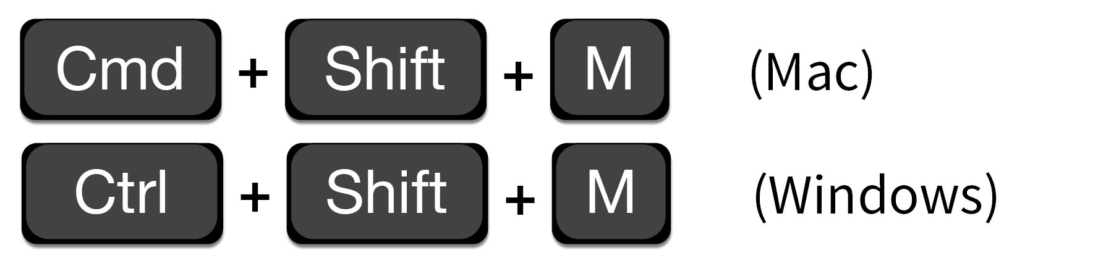

Shortcut to type |>
Note: The previous version of the pipe was %>% which can be used interchangeably with |>
Notes:
This pipe operator is going to be so useful to you you might as well learning a shortcut key that will type it out for you.
You can use either command, shift M on a mac or Ctrl shift M on a PC to save your fingers a few inches of movement.

Slide 13
Your Turn #1
Open “05 – Group and Summarize.qmd”
Start with the Setup Code Chunk section and work through the Sequencing Analysis Steps section
Sticky up when done

Slide 14
Summarize the data set
Notes:
Let’s start by introducing the concept of summarizing with with Summarize() function.

Slide 15
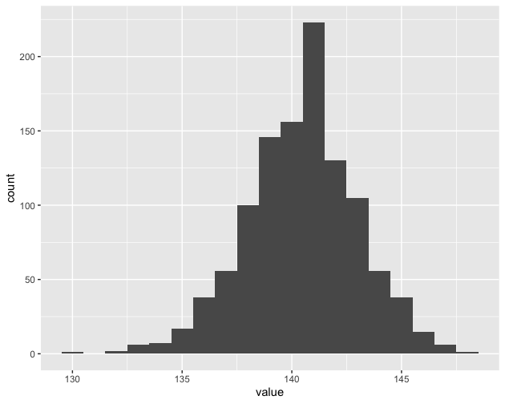
Q: What is the average sodium value?
Notes:
Here is a straightforward and practical question that we might ask of our data set.
What is the average sodium value

Slide 16
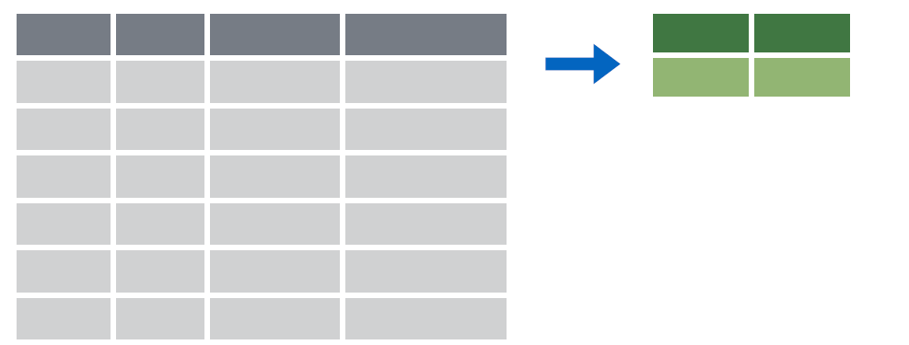
summarize()
Make summaries of your data
Notes:
Summarize allows us to take a variable (column) of data and apply a function (or functions) to all observations.
Using summarize we can return a single value, or summary.

Slide 17
summarize()
Make summaries of your data
dataframe |>
summarize(new_variable = calculation)
name for new variable
Value or function
Performs calculation across all rows of data frame
Notes:
To make summaries of our data we use the following code construct.
We pass a data set using pipes to the summarize function.
Within the summarize function we provide a variable name and set it to a calculation or value that we define.

Slide 18
summarize()
function that returns number of observations
Make summaries of your data
chem |>
filter(test == “sodium”) |>
summarize(sodium_count = n())
mrn | test | value
5001412 | sodium | 140
5000533 | sodium | 138
5009134 | sodium | 142
5008518 | sodium | 140
sodium_count
4
Notes:
Let’s look at a simple example using summarize() to count the number of orders in a data set.
Note, that to simplify the data frame, we first will select 2 variables and include the first 4 observations.
n() returns the number of observations or rows for a data frame.

Slide 19
summarize()
function that returns number of observations
Additional summaries = new columns
function applied to a specified variable
chem |>
filter(test == “sodium”) |>
summarize(sodium_count = n(),
median_sodium = median(value))
mrn | test | value
5001412 | sodium | 140
5000533 | sodium | 138
5009134 | sodium | 142
5008518 | sodium | 140
sodium_count
4
median_sodium
140
Notes:
Let’s look at a simple example using summarize() to count the number of orders in a data set.
Note, that to simplify the data frame, we first will select 2 variables and include the first 4 observations.
n() returns the number of observations or rows for a data frame.

Slide 20
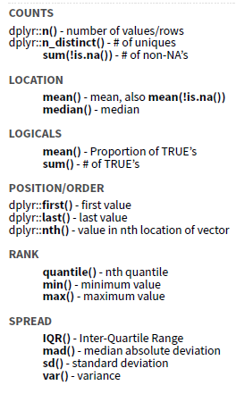
Notes:
There are many different summary functions.

Slide 21
Your Turn #2
Work through the Summarizing Variables section of the exercises
Sticky up when done
Notes:
8 mins

Slide 22
Notes:
There are many different summary functions.

Slide 23
Calculate the mean turnaround time
chem |>
mutate(total_tat = verify_dt – collect_dt) |>
summarize(total_tat_mean = mean(total_tat))
mrn | total_tat
5001412 | 3 days
5000533 | 4 days
5009134 | 5 days
5008518 | 6 days
total_tat_mean
4.5 days

Slide 24
Calculate the 75th percentile turnaround time
chem |>
mutate(total_tat = verify_dt – collect_dt) |>
summarize(total_tat_mean = mean(total_tat),
total_tat_75_pctile = quantile(total_tat, 0.75))
mrn | total_tat
5001412 | 6
5000533 | 8
5009134 | 10
5008518 | 11
total_tat_mean
4.5
total_tat_75_pctile
5.25

Slide 25
Grouping your data
Notes:
To answer this question we need to be able to group data.

Slide 26
group_by()
Notes:
Group_by is a challenging function to master, but extremely powerful. It is one of those tools that once you understand how to use, you cannot possibly go back to live without it.
Group_by allows us to take a data frame and break the observations up into several groups.
Then we can “look” at those groups separately.

Slide 27
group_by()
Grouping observations based on a specific variable’s values
dataframe|>
group_by(variable)
name of variable to group by
Notes:
Here is the code construct for grouping.
We pass a data set using pipes to the group_by() function.
Then we specify the variable that we want to define groups.

Slide 28
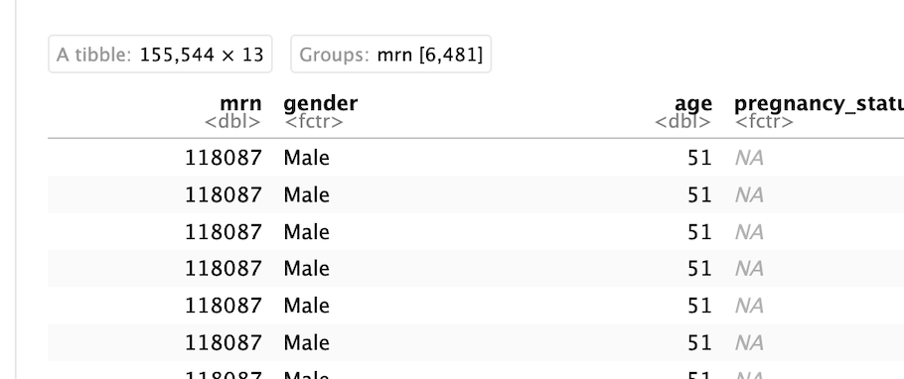
group_by()
Group observations by pan_day
chem |>
group_by(mrn)
entire dataframe
number of groups
Notes:
Let’s look at a example of grouping by pan_day.
We can see that the resulting object has 15,524 rows that are broken up into 102 groups.
This means there are 102 distinct `pan_day`’s.
Some of these groups will have a single observation. Many of these groups will have more than one observation.

Slide 29
group_by() |> summarize()

Slide 30
group_by()
|>
summarize()
Make summaries of your data by group
Notes:
Just like we can apply summarize() to a full data frame, we can apply summarize() to each group separately.
The combination of group_by() and summarize() is extremely powerful.

Slide 31
group_by() |> summarize()
Make summaries of your data
chem |>
summarize(test_count = n())
mrn | test
5001412 | sodium
5001412 | potassium
5009134 | bicarbonate
5009134 | chloride
test_count
155554
Notes:
Using summarize() without group_by() we can count how many total rows there are.

Slide 32
group_by() |> summarize()
Make summaries of your data
chem |>
group_by(mrn) |>
summarize(test_count = n())
mrn | test
5001412 | sodium
5000533 | potassium
5009134 | bicarbonate
5008518 | chloride
mrn
5001412
5000533
5009134
5008518
test_count
24
24
24
24
Notes:
Adding group_by(), we count how many rows there are for each `pan_day`.
This is the data that underlies the figure we looked at in slide 6.

Slide 33
Your Turn #3
Complete the Grouping and Summarizing section
Sticky up when done

Slide 34
Recap
Summarize() is a function that enables us to calculate summaries of variables (columns).
Common summary activities include counting observations using n(), counting unique observations using n_distinct(), and calculating means using mean().
Group_by() is a function that enables us to create subsets of data by a variable. Data can also be grouped by multiple variables.
Combining the group_by() and summarize() functions is a powerful way to look at summarizations across groups.

Slide 35
What else?

Slide 36
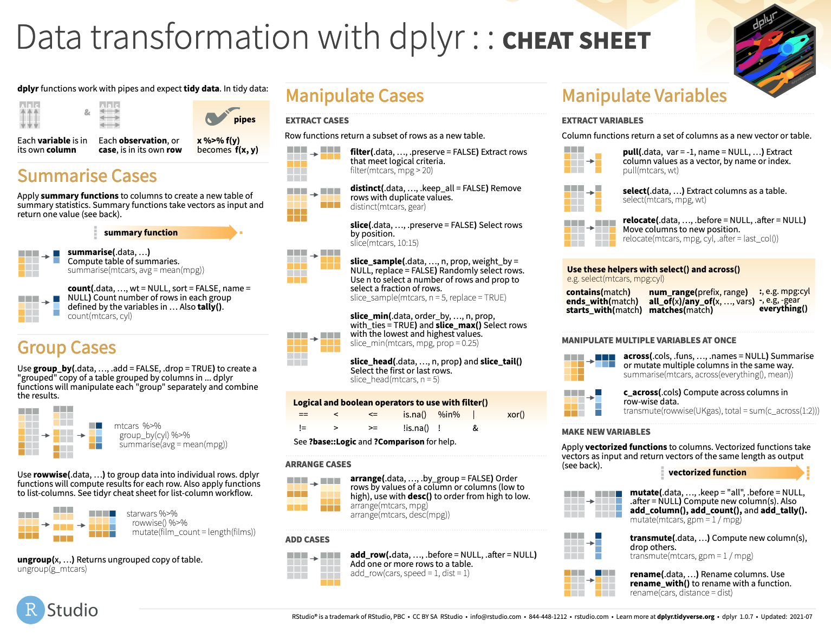
Notes:
The dplyr cheat sheet helps with the grammar of transforming data including functions functions grouping and summarizing data.
The dplyr cheat sheet is available on the RStudio website.

Slide 37
Lesson Goals
Construct a table that summarizes basic statistics (e.g., count, proportion, mean, range) of a dataset and its subgroups
Utilize programming and software tools to facilitate efficient, reproducible, and transparent data analytics workflows
Lesson Objectives
Link sequential data analysis steps together using the pipe operator to improve readability
Calculate a summary statistic for a variable using the summarize() function
Combine group_by() and summarize() functions to calculate summary statistics for groups of data

